Slide 1

Progress Review
WEB VULNERABILITY SCANNER Delivered By RAKHSHAN SAGRI, RASHMI RANE PG Diploma in Cybersecurity School of Computer Engineering and Technology MIT World Peace University, PUNE Under Supervision of Prof.Priyam BeBarta KPMG IN India

Slide 2


CONTENT
o1.
Objective of the Code
o2.
Introduction
o3.
Literature Review
o4.
Techniques Utilized
o5.
Outcomes
o6.
Future Scope
o7.
Conclusion

Slide 3

Objectives of the Project Work
Primary goal of the code :
- To assess security.
- To scan for vulnerabilities in a target system.
- Highlight the importance of assessment.

Slide 4

INTRODUCTION
Network security is of paramount importance in today's digital landscape, and this code leverages Python's capabilities to conduct comprehensive vulnerability assessments. To accomplish this, it employs a range of essential tools and libraries such as socket for network communication, requests for HTTP interactions, SSL for secure connections, pyfiglet presentation, and datetime for time-related operations. By assessing network vulnerabilities and scanning for potential threats, this code contributes to the proactive defense of digital assets, emphasizing the critical need for continuous network security vigilance.

Slide 5

One prominent aspect of network security assessment is header scanning, a technique that involves scrutinizing the HTTP response headers of a web server. This process aids in the detection of potential security issues such as missing security headers like 'X-Frame-Options,' which can lead to clickjacking vulnerabilities. Additionally, the absence of 'Content-Security-Policy' headers may indicate susceptibility to cross-site scripting (XSS) attacks, while the lack of 'Strict-Transport-Security' headers could suggest vulnerabilities related to SSL/TLS security.
Another critical dimension of network security assessment is robots.txt analysis. Robots.txt files are essential in controlling web crawling permissions for search engine bots and web scrapers. Analyzing these files can reveal the level of access and restrictions applied to web resources. Misconfigurations in robots.txt files can inadvertently expose sensitive data or allow unauthorized access.
Furthermore, certificate checking has emerged as a fundamental component of network security assessment. Certificates are essential for securing data in transit over HTTPS, and their proper configuration is paramount. By examining certificate expiry dates, we can assess SSL/TLS security and potential vulnerabilities. A certificate with a near expiry date poses a risk to the network's security, and timely detection of such certificates is essential to prevent disruptions.
In summary, the existing literature underscores the critical importance of header scanning, robots.txt analysis, and certificate checking in the realm of network security assessment. These techniques serve as vital tools in identifying and mitigating vulnerabilities that could be exploited by malicious actors, ensuring the continued integrity and security of networked systems.

Slide 6

LITERATURE REVIEW
Here, we explore the existing body of work and related research pertaining to network security assessment. This review sheds light on the established techniques and methodologies that have been widely recognized in the field of cybersecurity. Network security assessment has become increasingly crucial in today's digital landscape. It involves a comprehensive evaluation of a network's vulnerabilities, strengths, and potential weaknesses

Slide 7

TECHNIQUES LEARNED
In our code, we employ a combination of essential techniques to comprehensively assess network security:
1. Port Scanning: The code initiates a port scanning process to identify open ports within the target system's network. By utilizing Python's socket library, it attempts to establish connections with a range of ports, providing valuable information about which ports are accessible and potentially vulnerable
2. Header Scanning: Our code conducts header scanning by sending HTTP requests to the target URL and analyzing the response headers. This technique enables the detection of potential vulnerabilities. For instance, it checks for the presence of critical security headers such as "X-Frame-Options," "Content-Security-Policy," and "Strict-Transport-Security." The absence of these headers may indicate vulnerabilities such as clickjacking, potential cross-site scripting (XSS) threats, and SSL/TLS issues.

Slide 8

3. Robots.txt Analysis: In addition to port and header scanning, our code includes a feature for robots.txt analysis. By constructing the URL for the robots.txt file and sending an HTTP request, we determine whether web crawling permissions are appropriately configured. This analysis is vital for understanding how search engine bots and web crawlers interact with the target site, and misconfigurations could potentially expose sensitive information.
4. Certificate Expiry Check: Lastly, the code checks for SSL/TLS security by examining SSL certificates. It retrieves the SSL certificate for the target URL and extracts the certificate's expiration date. This allows us to assess the security of the SSL/TLS encryption. If the certificate is nearing expiration (typically within 30 days), it raises a warning, highlighting the need for prompt certificate renewal to maintain secure communication.
By integrating these techniques, our code helps users to identify open ports, potential vulnerabilities in response headers, web crawling permissions, and SSL/TLS security status. This comprehensive assessment aids in fortifying network defenses and mitigating potential security risks.

Slide 9
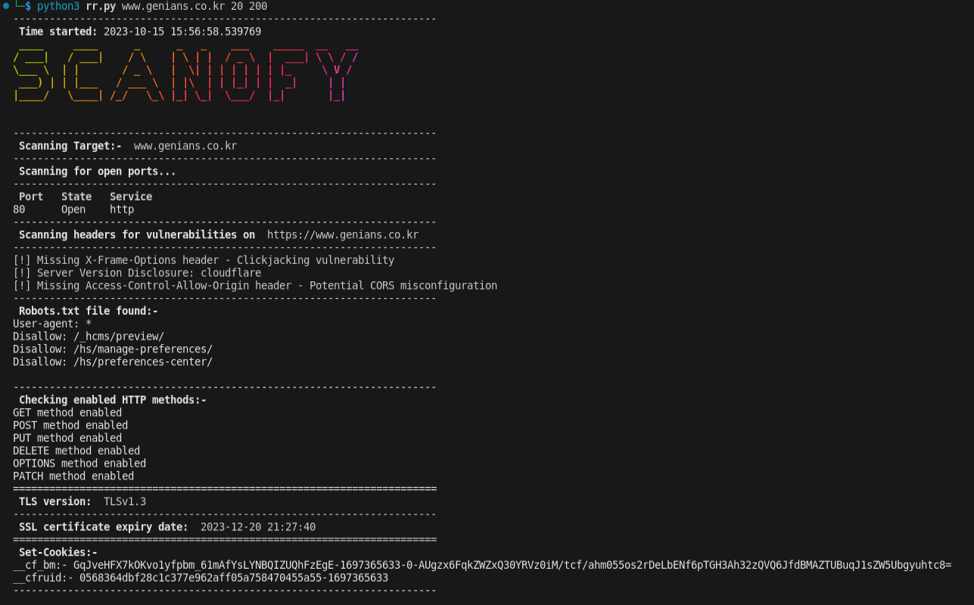
OUTCOME

Slide 10

FUTURE SCOPE
CASE STUDY
We explored a Python-based network security assessment and vulnerability scanning tool, named 'SCANOFY.' This tool demonstrates the significance of proactive network security by employing a multifaceted approach to assess potential vulnerabilities. SCANOFY leverages a range of Python libraries, including socket, requests, pyfiglet, and SSL, to comprehensively analyze a target system's security posture.
The case study begins with a clear objective: to enhance network security by identifying potential weaknesses in a website ‘www.irisflorist.com’. To achieve this, we integrated various scanning techniques and modules into our code. First, SCANOFY conducts a thorough port scan, meticulously examining a range of ports to identify any open ports, providing valuable insights into potential points of entry.

Slide 11

FUTURE SCOPE
Additionally, SCANOFY conducts header scanning, scrutinizing HTTP response headers for critical security-related information. This includes checks for the presence of crucial security headers such as 'X-Frame-Options,' 'Content-Security-Policy,' and 'Strict-Transport-Security.' Any missing headers can signify vulnerabilities, such as clickjacking, potential XSS (Cross-Site Scripting) attacks, and SSL/TLS-related security issues.
Furthermore, SCANOFY performs robots.txt analysis to assess web crawling permissions, ensuring that critical sections of a website are appropriately protected from web crawlers and search engine indexing.
To round out its capabilities, SCANOFY conducts SSL certificate checks, monitoring the validity and expiration date of SSL/TLS certificates on the target system. This feature ensures that websites maintain the highest standards of encryption and security.

Slide 12
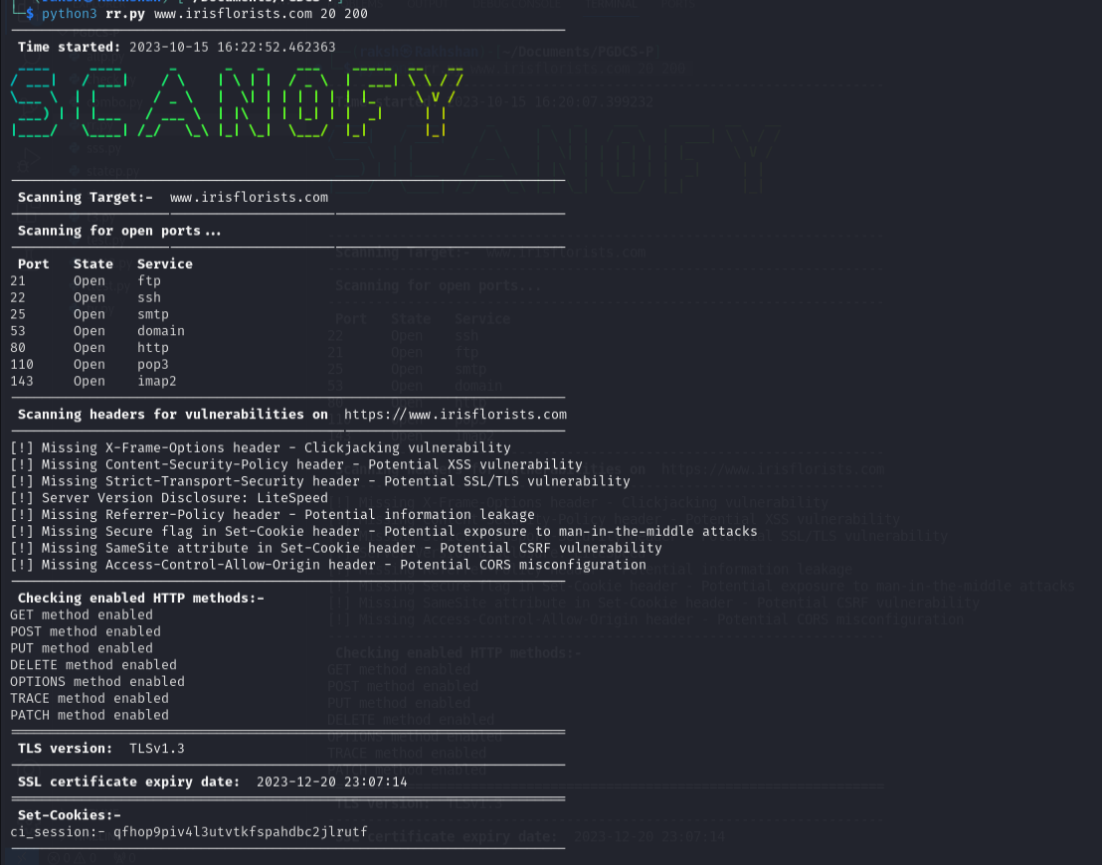
OUTCOME

Slide 13
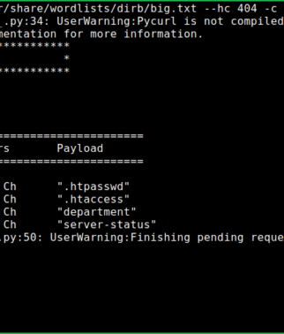
FUTURE SCOPE
In terms of future scope, for enhancing the capabilities of our network security assessment and vulnerability scanning tool following things could be done such as:
Directory Brute-Forcing: One promising direction is to expand the code to include directory brute-forcing. This would involve systematically testing a wide range of directories and file names to uncover hidden or unauthorized access points on a web server. By doing so, we can further identify potential vulnerabilities, misconfigurations, or sensitive information that might be exposed.

Slide 14
2. Automation for Periodic Scans: To ensure ongoing security, automating the code for periodic scans is crucial. Implementing scheduled scans at regular intervals enables organizations to proactively identify and address vulnerabilities as they arise, reducing the window of opportunity for potential attackers. Automation can also generate reports for security teams to review and act upon.
3. Handling More Complex Security Checks: As cybersecurity threats continue to evolve, extending the code's capabilities to handle more complex security checks is essential. This could involve the inclusion of advanced vulnerability assessment techniques, such as fuzz testing, code analysis, and machine learning-based anomaly detection, to address emerging security challenges effectively.

Slide 15

Our project underscores several critical takeaways. First and foremost, we've seen the paramount importance of conducting regular security assessments in today's digital landscape, where cyber threats are continuously evolving. Our Python-based code has demonstrated its efficacy in identifying vulnerabilities.As we wrap up, it's crucial to reiterate the enduring need for ongoing network security efforts. The threats we face are dynamic, and a proactive, vigilant approach to security is our best defense. By leveraging such tools, organizations can stay one step ahead of potential attackers and ensure the integrity and resilience of their network infrastructure. In this ever-changing cybersecurity landscape, security assessments are not just a practice; they are a necessity.

Slide 16


